Slide 1

National Annual Nonprofit Conference
Name:
Tutor:
Course:
Date:

Slide 2

Overview Information
A nonprofit organization is not taxed.
It furthers a social cause.
Provides a public benefit.
NPOs further:
cruelty-prevention
public safety
literary.
Educational
Charitable
scientific
Religion.
Notes:
A nonprofit organization (NPO) refers to a business or organization that is not taxed by the government since it provides a public benefit as well as furthering a social cause. The organizations receives donations from individuals or organizations after which it does not remit tax upon receipt (Powell, & Steinberg, 2006). An organization is designated to be a nonprofit organization only if it furthers public safety, literary, educational, charitable, scientific, religious or cruelty-prevention causes. Some of the nonprofit organizations include foundations, churches, national charities, universities and hospitals. The NPOs are required by law to present their financial and operating details to the public so that the donors can know how well their contributions are being utilized (Powell, et al., 2006).

Slide 3
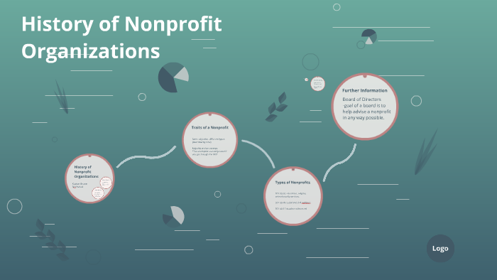
History of Nonprofit Organizations
Began in the 1800s
The US entered in a Progressive Era.
Increased social activism and political reform
The country experienced immense prosperity and success.
Increase in wealth led to increased giving back.
Andrew Carnegie released the gospel of wealth in 1889
Promoted the idea of owing a duty to community
Encouraged donating to causes.
Notes:
The Nonprofit organizations started to grow in the United States of America in the 1800s. This was a time that marked the ushering of the progressive era in the United States. The progressive era gave rise to increased social activism as well as political reforms. The United States experienced immense prosperity which made the country to accumulate a lot of wealth. It also turned out when there was increased wealth, also giving back to the society began (Powell, et al., 2006). To support the idea of giving back to the society for a cause, Andrew Carnegie released the gospel of wealth in 1889.

Slide 4
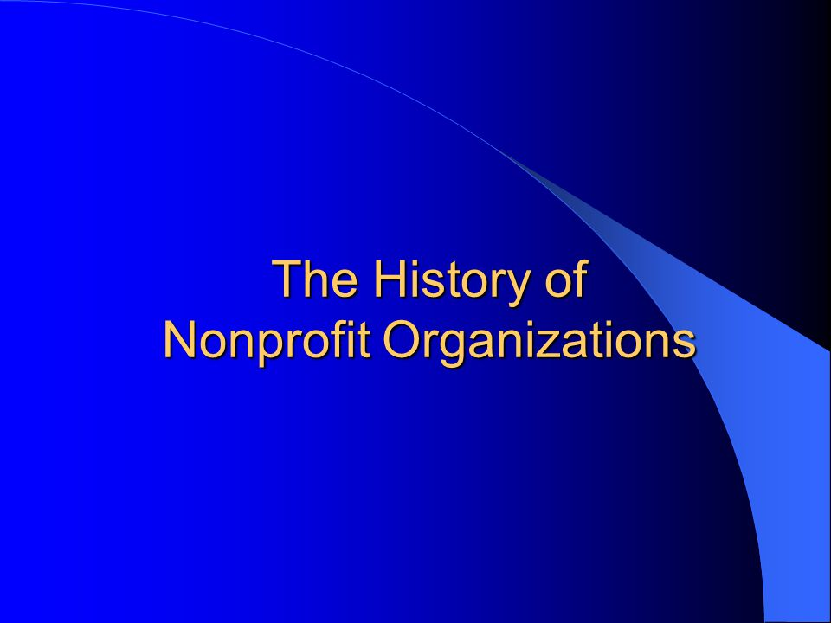
Cont…,
World War II caused fear to the Americans.
Americans decided to help out with effort from home.
They came together for the first time to fundraise on a global scale.
Began to conserve resources.
They send supplies to troops overseas.
Established civilian and refugee relief programs.
Volunteering and fundraising took the form of a collaborative efforts.
America Red Cross and the National Jewish Welfare Board began.
Notes:
As the World War II was happening, it brought fear to the Americans. They decided it was time that they helped the situation from home. This was the first time in the country’s history to ever come together to fundraise on a global scale. They decided to begin conserving resources which could be send to their troops overseas. They therefore established both a refugee and a civilian relief program. Much of the work that was done was done due to the collaborative efforts from the Americans. In addition, they decided to form service organizations such as the National Jewish Welfare Board and the American Red cross.

Slide 5

Cont…,
Shift brought o by the cultural resistance and civil rights movement resisted the invasion of Vietnam in 1965.
Americans came together to tackle such issues.
The United States government became much more involved in social and cultural welfare programs.
Tax Reform Act created Section 501©3 in the Internal Revenue Service Code.
Notes:
In 1965, there was a shift that brought on the Civil Rights Movement and the cultural resistance to entering Vietnam. This was another indication that the American society was cohesive and had decided to work together. The Americans got organized and worked together towards resolving certain problems with a narrow focus. The United States of America government started to be more involved in cultural as well as social welfare programs (Vaughan, & Arsneault, 2014). For instance, with the look of the way the society was concerned with social and cultural issues, the government saw a need to exempt organizations that were meant for social cause from paying tax. This is the point where the Tax Reform Act gave rise to section 501©3 in the internal revenue service code.

Slide 6

Cont…,
In 2000 the society moved into a new millennium.
The internet was introduced in 1991
World Wide Web was made available for public in 1991.
This forced organizations to adopt the change.
Nonprofit organizations utilized the web.
In 2012, it increased donations to the nonprofits to a tune of $2.1 billion
Notes:
As the world was ushering a new dawn in connecting the society, the World Wide Web made the world to turn into a single society. People could now communicate and do things from different areas. Therefore, it meant that now the nonprofit organizations could get more donations. In 1991, the World Wide Web was made available for public use. This was the opportunity that would make the nonprofit organizations saw the growth of the donations channeled to them (Agard, 2011). Therefore, this was an opportunity that the nonprofit organizations could not let go. In 2012, the nonprofit organizations received $2.1 billion online donations.

Slide 7
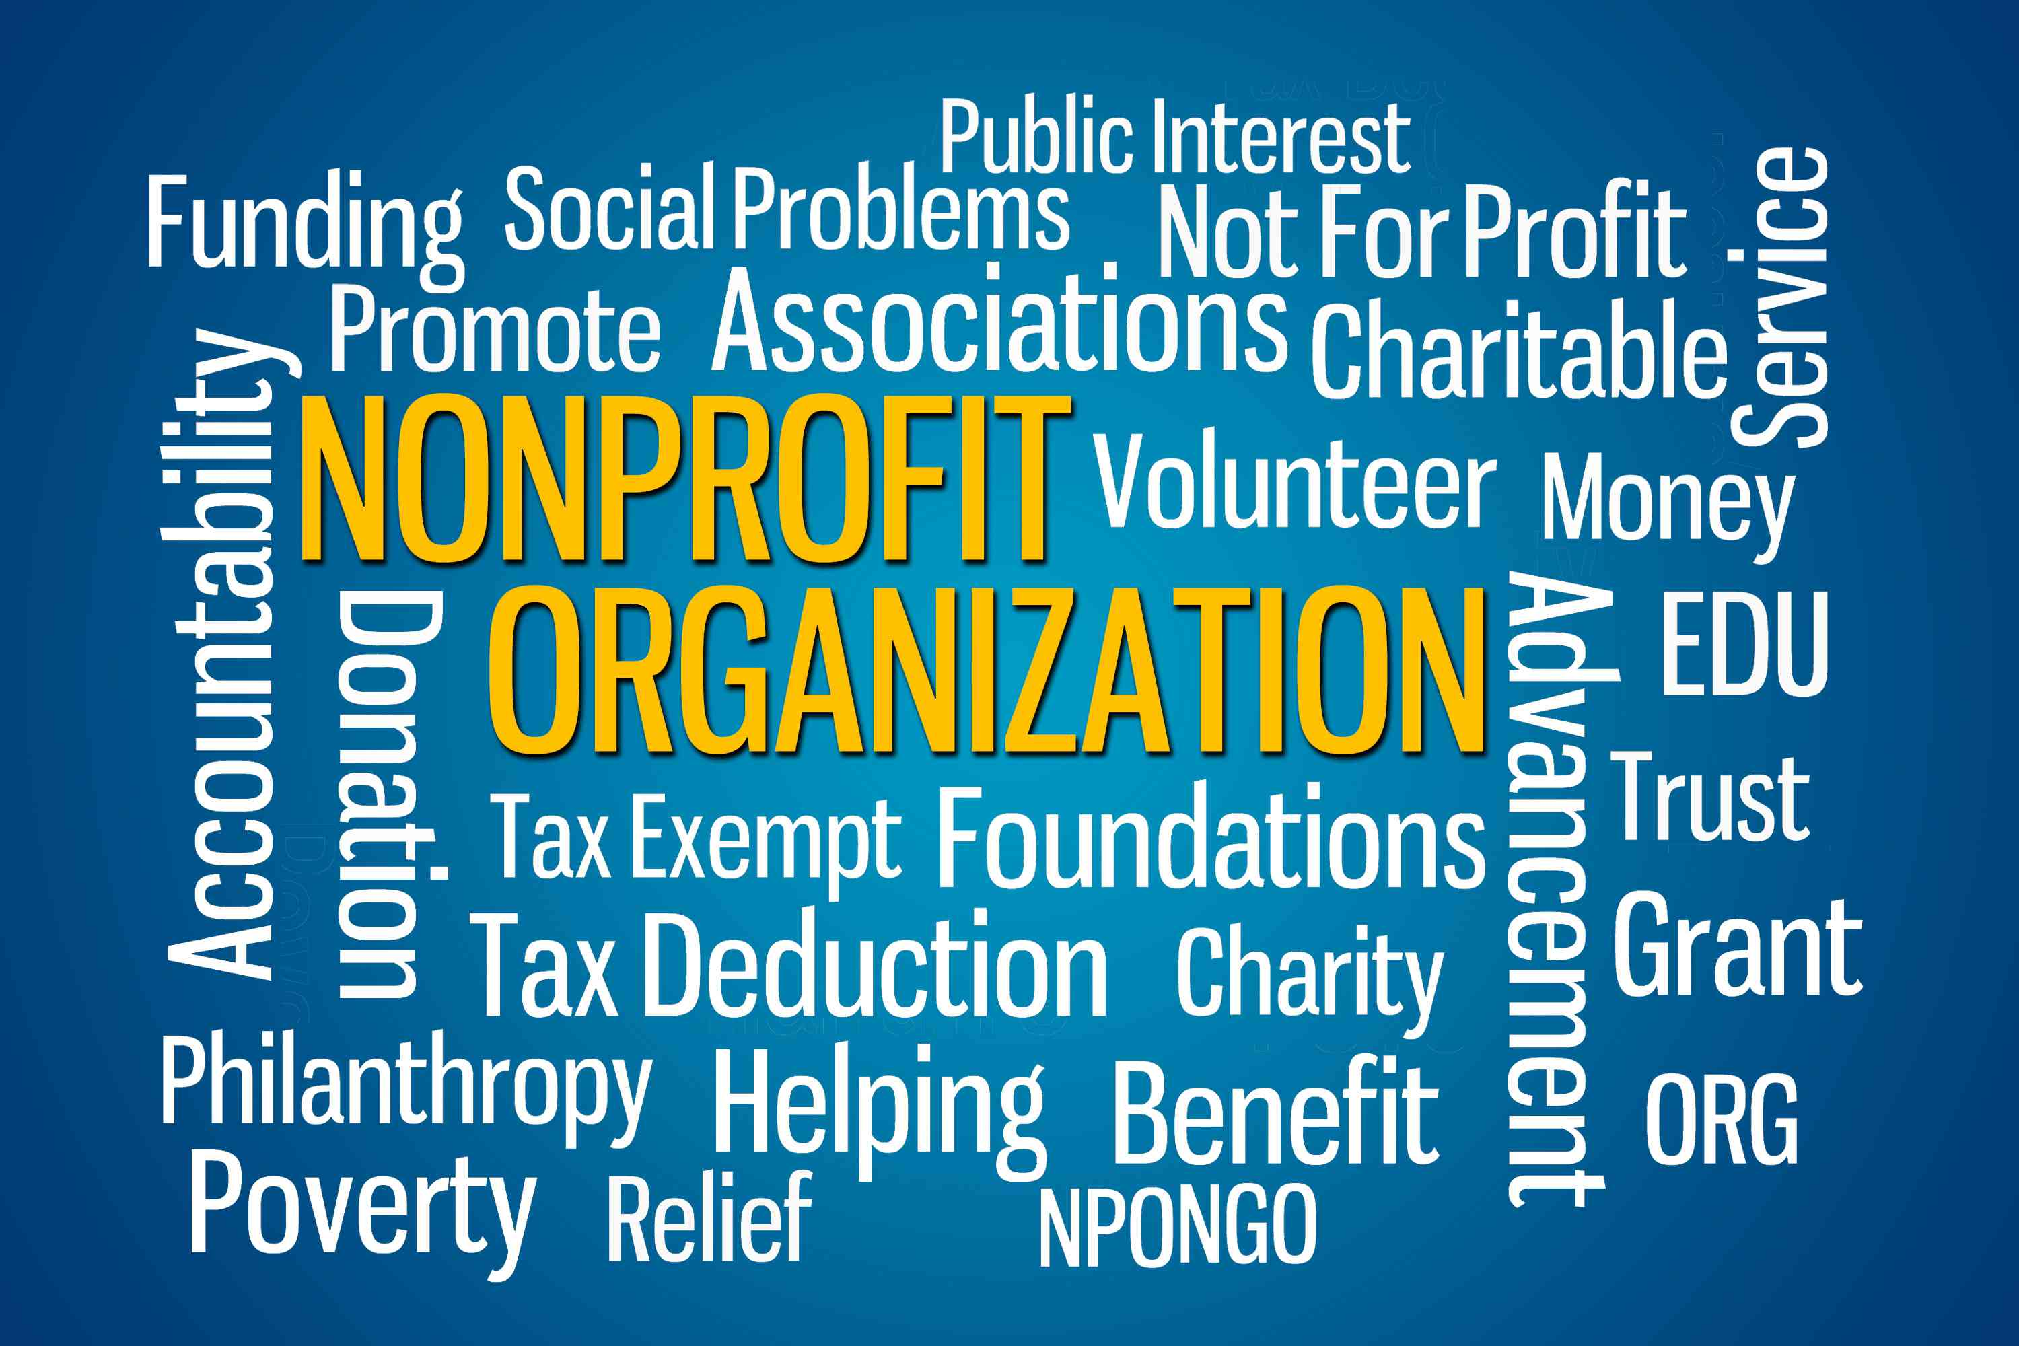
Significant Legislative Changes
In 1934 Congress enacted a statute that exempted nonprofit organizations from paying taxes.
This saw the introduction of 501©3
In 1976congrsss clarified that charitable nonprofits may provide clear guidelines, create generous limits, lobby and create other benefits.
Form 5768 allows nonprofit organizations to safely engage in lobbying activities.
Money that is spent on lobbying falls under an established threshold.
Notes:
The federal and state governments exert control over the nonprofit organizations. For instance, they require the nonprofit organizations not to contribute taxes. The government and the states have passed some legislative measures that are meant to ensure the organizations are well governed and are not misused by the politicians. For instance, the provision in the 501(c) (3) code forbids the nonprofit organizations from getting involved in politics in any way. If this act did not forbid any kind of involvement in politics, some nonprofit organization might have opposed or endorsed a certain politician. In addition, form 5768 allows nonprofit organizations to engage safely in lobbying activities (Vaughan, et al., 2014).

Slide 8
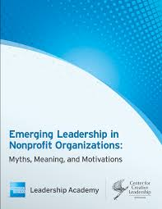
The Nonprofit Sector Today
The number of nonprofit organizations seems to be increasing.
Following report by the National Center for Charitable Statistics, there are more than 1.5 million nonprofit organizations that are registered in America.
This number of nonprofit organizations includes ; private foundations, public charities and other kinds of nonprofit organizations.
Some of the most popular NPOs in the US include:
The YMCA
Goodwill Industries International
Catholic Charities USA
The Salvation Army, among others
Notes:
The number of the Nonprofit Organizations (NPOs) in the United States seems to be increasing over time. Initially, there were about three main NPOs which included the Red Cross, the YMCA and the Salvation Army. However, currently the National Center for Charitable Statistics has indicated that there are more than 1.5 million registered nonprofit organizations within the US. There are nonprofit organizations that are popular than others in the present day. The nonprofit organizations which is ranked position one currently is Metropolitan Museum of Art. It is followed by American Civil Liberties Union Foundation, Amnesty International United States of America and the Planned Parenthood Federation of America.

Slide 9

Emerging Leadership in Nonprofit Organizations
There has been a need to improve leadership in NPOs.
The American Express Nonprofit Leadership Academy has embarked on developing emerging leaders in the nonprofit industry.
The American express and the center for creative leadership has also been taking part in developing emerging leaders in the nonprofit sector.
Notes:
Leadership is very important in running any kind of organizations. Therefore, it is important to have leaders who are focused on taking the nonprofit sector to the next level. This is the reason why there has come up organizations that are meant to improve leadership within the nonprofit sector (Agard, 2011). Since leadership is not brought or produced by one person, different people have come together to create the kind of leadership that could fit within the nonprofit sector. This is the point where the American Express Nonprofit Leadership Academy together with the American Express and the Center for Creative Leadership came in to help (Vaughan, et al., 2014).

Slide 10
References
Agard, K. A. (2011). Leadership in nonprofit organizations: A reference handbook. Los Angeles [Calif.: SAGE.
Powell, W. W., & Steinberg, R. (2006). The nonprofit sector: A research handbook. New Haven: Yale University Press.
Vaughan, S. K., & Arsneault, M. (2014). Managing nonprofit organizations in a policy world.

